Slide 1



Apr 30th, 2018

Slide 2








Pending
Pending
We started with more than 50K listings for NYC and decided to focus on 3 neighborhoods
After that, we made an analysis and built our models with 5,296 datapoints corresponding to rooms available from AirBNB data, however, some of them are not longer available
When we incorporated Ratings Analysis, we found data points for 3,666 of them and performed a new analysis of them
Additionally, we performed sentiment analysis, price correlation, reviews correlation among other analysis
Finally, we built an interactive dashboard to help with the decision
Notes:
Understand the process to find the investing companies is done manually. It is manually done, they don’t have the right criteria, they can have missed opportunities.
Possible solution
Have an automatic process based on selected criteria that can be automatically updated in order to enhance the selecetion process and giving them the time to focus on what matters, building the relation.
There is no database or control group
Prioritization of clients for reaching them

Slide 3
Our first step was analyzing the data we gathered directly from AirBNB databases
The data we obtained, contained +50K datapoints for NYC with features including location, price and amount of reviews
id | name | host_id | host_name | neighbourhood_group | neighbourhood | latitude | longitude | room_type | price | minimum_nights | number_of_reviews | last_review | reviews_per_month | calculated_host_listings_count | availability_365
2454 | superCondo | 2688 | Ben | Manhattan | Midtown | 40.75552 | -73.9677 | Entire home/apt | 137 | 7 | 1 | 30-01-19 | 1 | 1 | 65
2539 | Clean & quiet apt home by the park | 2787 | John | Brooklyn | Kensington | 40.64749 | -73.9724 | Private room | 149 | 1 | 9 | 19-10-18 | 0.23 | 8 | 365
2595 | Skylit Midtown Castle | 2845 | Jennifer | Manhattan | Midtown | 40.75362 | -73.9838 | Entire home/apt | 225 | 1 | 43 | 02-01-19 | 0.38 | 2 | 365
3330 | ++ Brooklyn Penthouse Guestroom ++ | 4177 | Jbee | Brooklyn | Williamsburg | 40.70856 | -73.9424 | Private room | 70 | 5 | 39 | 07-12-18 | 0.35 | 3 | 290
3647 | THE VILLAGE OF HARLEM....NEW YORK ! | 4632 | Elisabeth | Manhattan | Harlem | 40.80902 | -73.9419 | Private room | 150 | 3 | 0 |  |  | 1 | 365
3831 | Cozy Entire Floor of Brownstone | 4869 | LisaRoxanne | Brooklyn | Clinton Hill | 40.68514 | -73.9598 | Entire home/apt | 89 | 1 | 231 | 17-01-19 | 4.37 | 1 | 162
5022 | Entire Apt: Spacious Studio/Loft by central park | 7192 | Laura | Manhattan | East Harlem | 40.79851 | -73.944 | Entire home/apt | 80 | 10 | 9 | 19-11-18 | 0.11 | 1 | 48
5099 | Large Cozy 1 BR Apartment In Midtown East | 7322 | Chris | Manhattan | Murray Hill | 40.74767 | -73.975 | Entire home/apt | 185 | 2 | 70 | 02-12-18 | 0.59 | 1 | 0
5121 | BlissArtsSpace! | 7356 | Garon | Brooklyn | Bedford-Stuyvesant | 40.68688 | -73.956 | Private room | 60 | 45 | 49 | 05-10-17 | 0.42 | 1 | 0
…
As we can see, there are no features referring to customer experience (ratings or reviews), however, we aimed to find a model to predict price and estimate the best “value” option
Notes:
Understand the process to find the investing companies is done manually. It is manually done, they don’t have the right criteria, they can have missed opportunities.
Possible solution
Have an automatic process based on selected criteria that can be automatically updated in order to enhance the selecetion process and giving them the time to focus on what matters, building the relation.
There is no database or control group
Prioritization of clients for reaching them

Slide 4
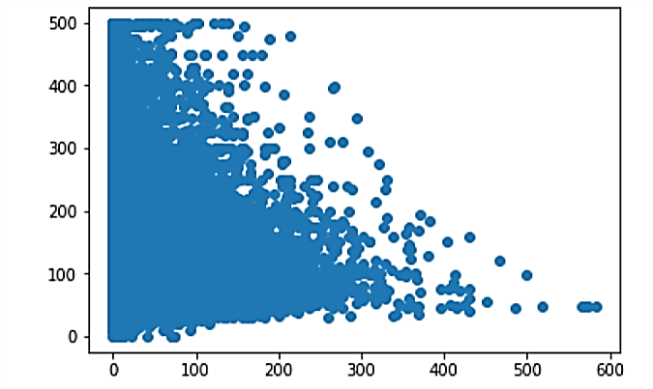
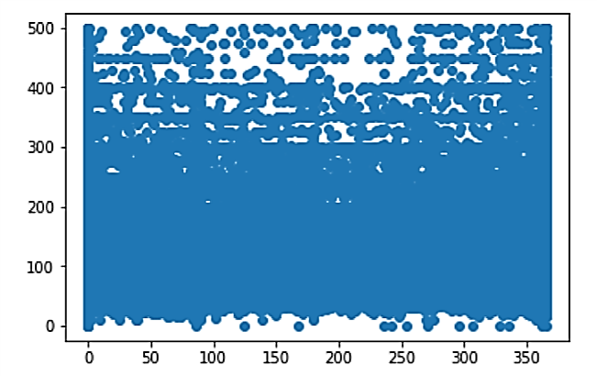
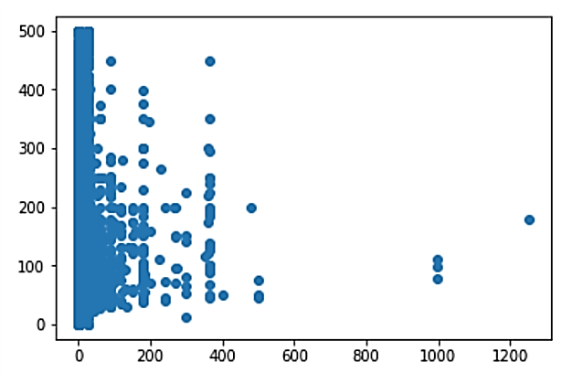
We started by processing the data and looking for a correlation between the available features and the impact on the price
The three main features we looked at initially in order to try to understand the price were the reviews, the availability and the minimum nights required
# of Reviews vs Price
Availability vs Price
Minimum Nights vs Price
After this analysis, we can see that the number of reviews doesn't explain the price. We can drop this feature as it is not explanatory
We conclude that availability is not an explanatory feature for the price, it shows no identifiable pattern
We can see some slight relation in long stays, but for most listings which require few nights, it is not explanatory
Notes:
Understand the process to find the investing companies is done manually. It is manually done, they don’t have the right criteria, they can have missed opportunities.
Possible solution
Have an automatic process based on selected criteria that can be automatically updated in order to enhance the selecetion process and giving them the time to focus on what matters, building the relation.
There is no database or control group
Prioritization of clients for reaching them

Slide 5


After reviewing the original data, we found that potential relevant data was missing and we decided to gather it
We built a scraper for AirBNB and used it on the 5000+ data points corresponding to the 3 neighbourhoods analyzed
Room | Stars | Accuracy | Communication | Cleanliness | Location | Check-In | Value
5203 | 5 | 10 | 10 | 10 | 10 | 10 | 10
5295 | 4.5 | 10 | 10 | 9 | 9 | 10 | 9
6021 | 4.5 | 9 | 10 | 10 | 9 | 10 | 9
9668 | 4.5 | 9 | 9 | 7 | 9 | 9 | 9
9704 | 5 | 10 | 10 | 9 | 10 | 10 | 10
…
We obtained the Rankings across 6 different categories as well as the overall Ranking (Stars)
Room | Review 1 | Review 2 | Review 3 | Review 4 | Review 5 | Review 6 | Review 7 | Description
5203 | "fantastic. great stay and nice people " | "Great location, 5min walk to Columbia campus;... | "Great price for the room and location. My hos... | "Welcoming space, clean, great location, comfo... | "Hands down my favorite Airbnb listing where I... | "MaryEllen is a very nice, hospitable person. ... | "The whole family is amazing, including their ... | sectioned_description":{"access":"Guests will ...
5295 | "Great option for a trip to NYC!!!!! Quick res... | "The host canceled this reservation 14 days be... | "Great place. Great location \nSuper Host. \n... | "This a perfect place! Perfect location (Uppe... | "Lena is a very thoughtful and attentive host.... | "Great location." | "Lena was a terrific host, and her apartment i... | sectioned_description":{"access":null,"author_...
6021 | "I would first like to start by saying that Cl... | "My stay was beyond pleasant! Claudio has a be... | "Claudio’s place was great. Only 2 short block... | "This is one of the best Airbnb apartment I’ve... | "This is an amazing location - across the stre... | "The reservation was canceled 7 days before ar... | "Claudio's apartment was a great find! It is c... | sectioned_description":{"access":"Guests are w...
9668 | "This is probably one of the best places to st... | "We met Donaldo and he was very sweet and prov... | "I didn't meet Trip, but his co-host managed e... | "Big applauds to a co-host Donald. He was very... | "pretty comfortable place and accessible to an... | "I’ll begin by saying, “you get what you pay f... | "Trip was very flexible and accommodating!" | sectioned_description":{"access":"bedroom, bat...
…
We took the latest 7 reviews for each of the rooms as they are the most representative
We also obtained the Description of the Listing
With these features we were able to perform additional analysis
Notes:
Understand the process to find the investing companies is done manually. It is manually done, they don’t have the right criteria, they can have missed opportunities.
Possible solution
Have an automatic process based on selected criteria that can be automatically updated in order to enhance the selecetion process and giving them the time to focus on what matters, building the relation.
There is no database or control group
Prioritization of clients for reaching them

Slide 6
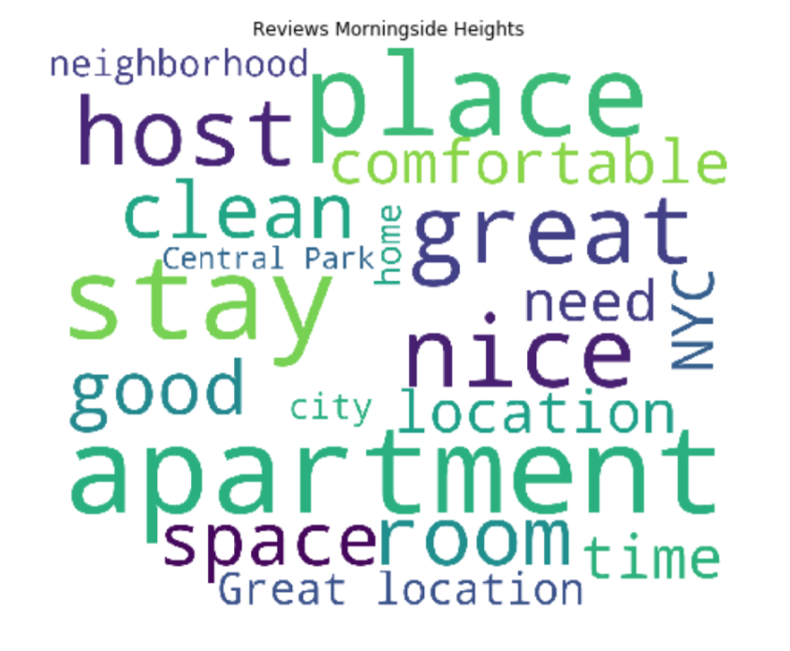
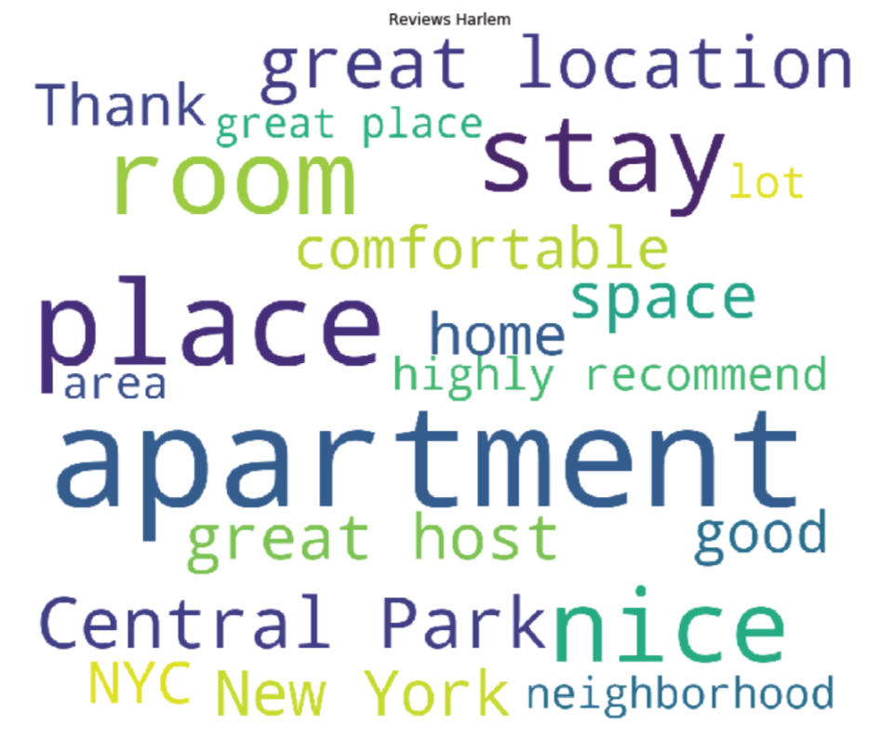
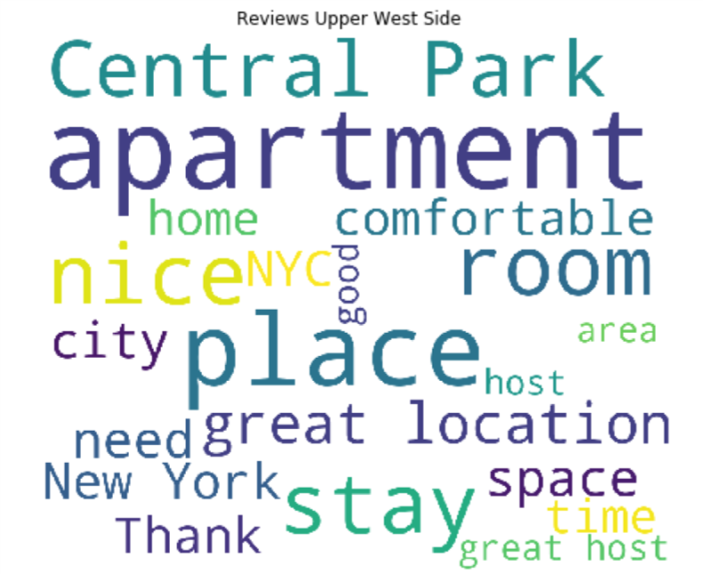
We performed Sentiment analysis in order to obtain an additional point of comparison for our friends and family
After performing sentiment analysis on the 3 neighbourhoods we concluded that they have virtually the same perception
Positive | Negative | Neutral | Compound
26% | 2% | 72% | 40%
Positive | Negative | Neutral | Compound
27% | 2% | 71% | 41%
Positive | Negative | Neutral | Compound
27% | 2% | 71% | 41%
Given this similarity, the decision should depend on other factors such as room features, price, location, etc.
Notes:
Understand the process to find the investing companies is done manually. It is manually done, they don’t have the right criteria, they can have missed opportunities.
Possible solution
Have an automatic process based on selected criteria that can be automatically updated in order to enhance the selecetion process and giving them the time to focus on what matters, building the relation.
There is no database or control group
Prioritization of clients for reaching them

Slide 7
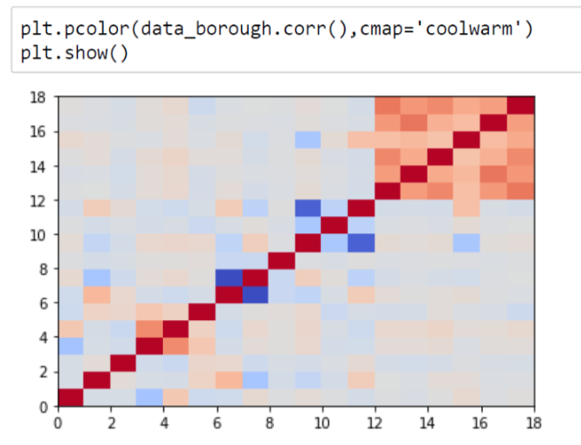
Blue Cloud Ventures requires an automatic process to prioritize which companies they should reach out to
Currently, the process to select which companies should be approached consist of manual processes. This could be improved by implementing a standardized method
#First, we try to suppress some features to reduce overfitting
del data_borough['Value']
del data_borough['Cleanliness']
del data_borough['Check-In']
The results are slightly better than for the previous model without outliers. It is not very surprising since
the price and the ratings were barely correlated. We verify that the ratings are not very explanatory of the
price.
Notes:
Understand the process to find the investing companies is done manually. It is manually done, they don’t have the right criteria, they can have missed opportunities.
Possible solution
Have an automatic process based on selected criteria that can be automatically updated in order to enhance the selecetion process and giving them the time to focus on what matters, building the relation.
There is no database or control group
Prioritization of clients for reaching them

Slide 8
Pending
Pending
Notes:
Understand the process to find the investing companies is done manually. It is manually done, they don’t have the right criteria, they can have missed opportunities.
Possible solution
Have an automatic process based on selected criteria that can be automatically updated in order to enhance the selecetion process and giving them the time to focus on what matters, building the relation.
There is no database or control group
Prioritization of clients for reaching them

Slide 9

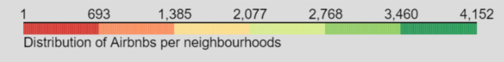
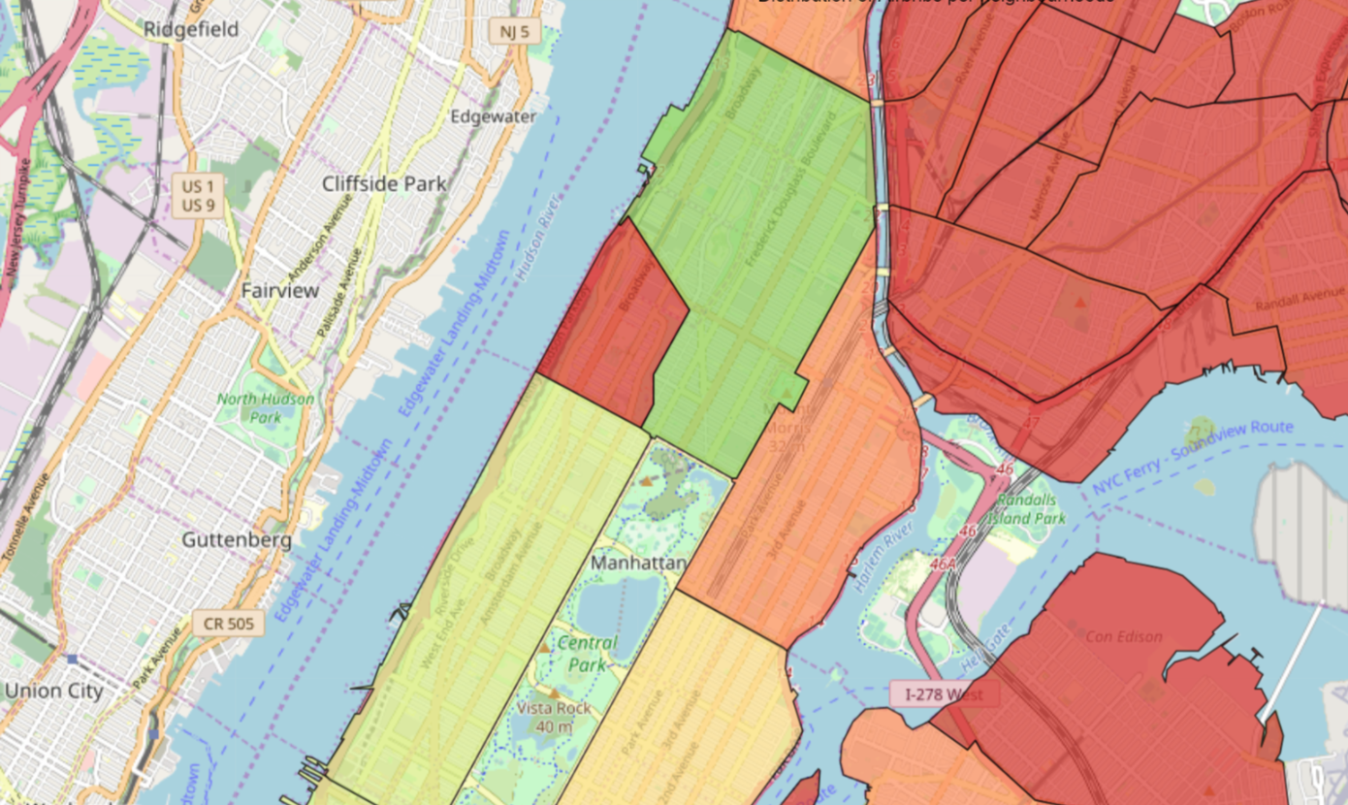
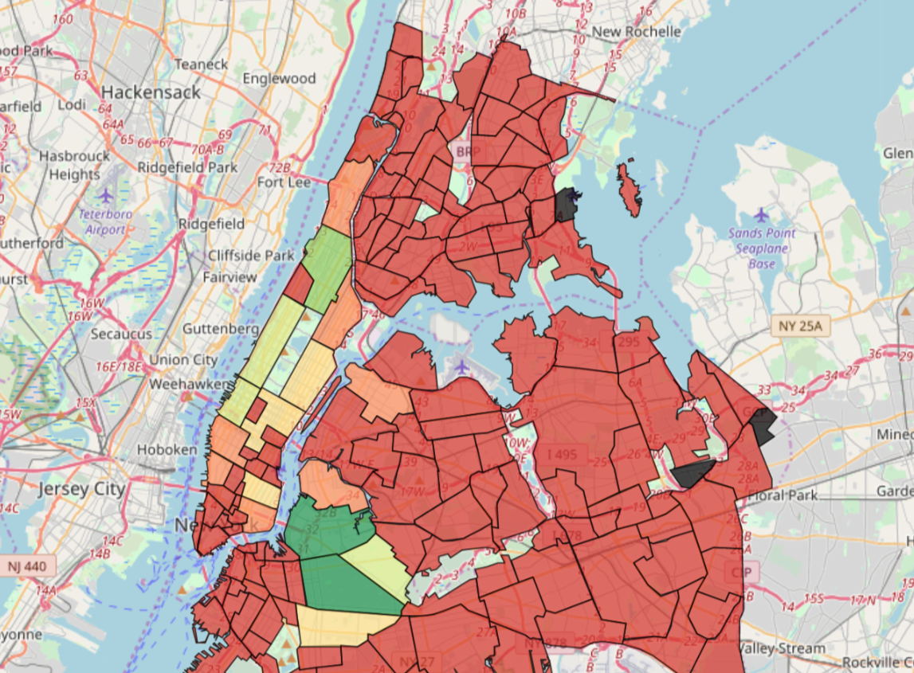

Pending
Pending
Distribution of Listings
Harlem has the most listings available and Morningside shows a very limited amount of them, both due to its size and the “student” nature of the neighborhood
Notes:
Understand the process to find the investing companies is done manually. It is manually done, they don’t have the right criteria, they can have missed opportunities.
Possible solution
Have an automatic process based on selected criteria that can be automatically updated in order to enhance the selecetion process and giving them the time to focus on what matters, building the relation.
There is no database or control group
Prioritization of clients for reaching them

Slide 10

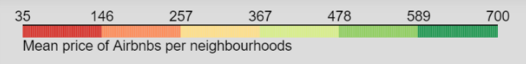
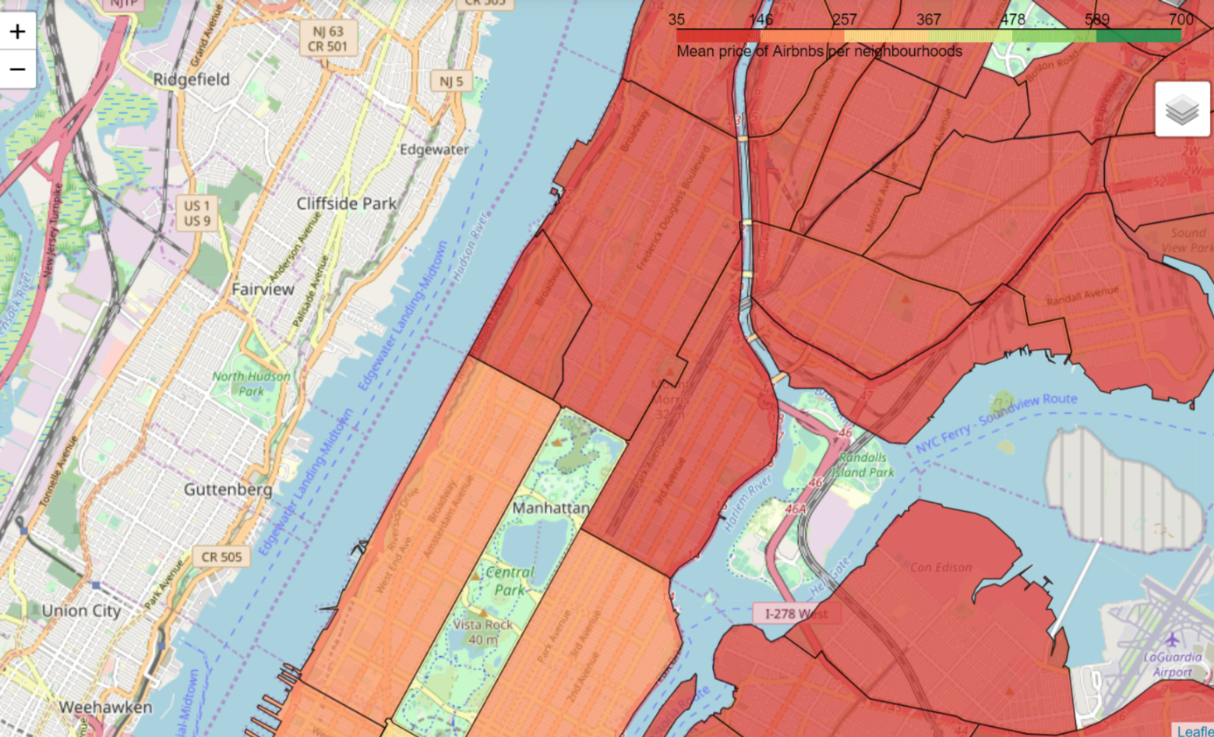
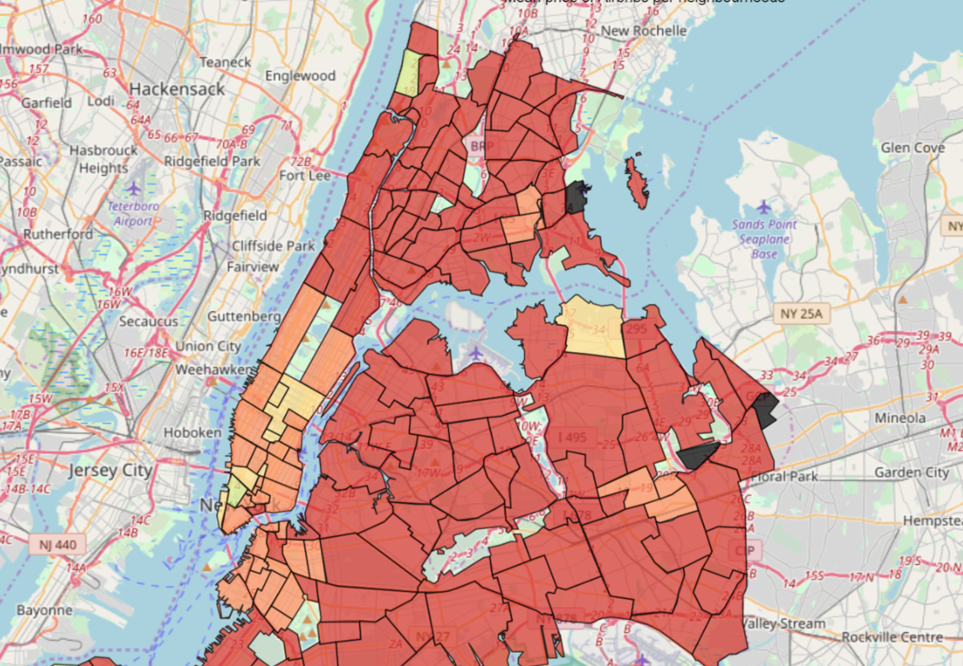
Pending
Pending
Mean Price
We can observe than in average, UWS has slighter higher prices than the other 2 analyzed neighborhoods, this is expected as it is closer to midtown
Notes:
Understand the process to find the investing companies is done manually. It is manually done, they don’t have the right criteria, they can have missed opportunities.
Possible solution
Have an automatic process based on selected criteria that can be automatically updated in order to enhance the selecetion process and giving them the time to focus on what matters, building the relation.
There is no database or control group
Prioritization of clients for reaching them

Slide 11
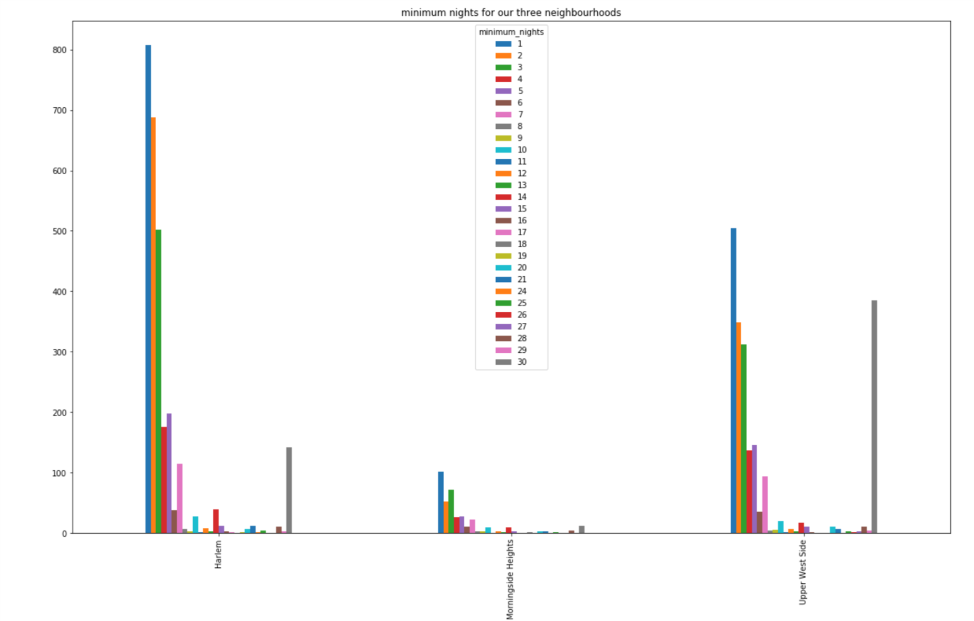
Pending
Pending
Notes:
Understand the process to find the investing companies is done manually. It is manually done, they don’t have the right criteria, they can have missed opportunities.
Possible solution
Have an automatic process based on selected criteria that can be automatically updated in order to enhance the selecetion process and giving them the time to focus on what matters, building the relation.
There is no database or control group
Prioritization of clients for reaching them

Slide 12






In summary, we analysed and built several models to understand better the dynamics of AirBNB in NY
We focused on the 3 closest neighbourhoods to Columbia University to offer an option to friends and family attending commencement
The following are the main conclusions on the various analysis performed:
Manhattan is a very peculiar area in which prices are not exactly correlated to Ratings.
The High Demand experienced all-year round in almost every “central” neighbourhood might be one of the main reasons for this
The amount of reviews and its consistency is one of the few available features that can help with a decision
All 3 Target Neighbourhouds share virtually the same perception based on the available reviews, therefore this is not a relevant decision maker in this particular situation
Reviews
Sentiment Analysis
AirBNB appears to be a self-discriminating platform. We can conclude this from the listings available, the reviews are in general very good which might be an indicator of bad hosts and their listings dropping out of the platform
Price depends on the facilities and the services offered and not on reviews or location in this particular case
Morningside Heights has the less amount of options, followed by UWS. Harlem has the most available listings
Price
Neighbourhood
We decided to build an interactive Dashboard to help in the selection of the best experience
Notes:
Understand the process to find the investing companies is done manually. It is manually done, they don’t have the right criteria, they can have missed opportunities.
Possible solution
Have an automatic process based on selected criteria that can be automatically updated in order to enhance the selecetion process and giving them the time to focus on what matters, building the relation.
There is no database or control group
Prioritization of clients for reaching them

Slide 13
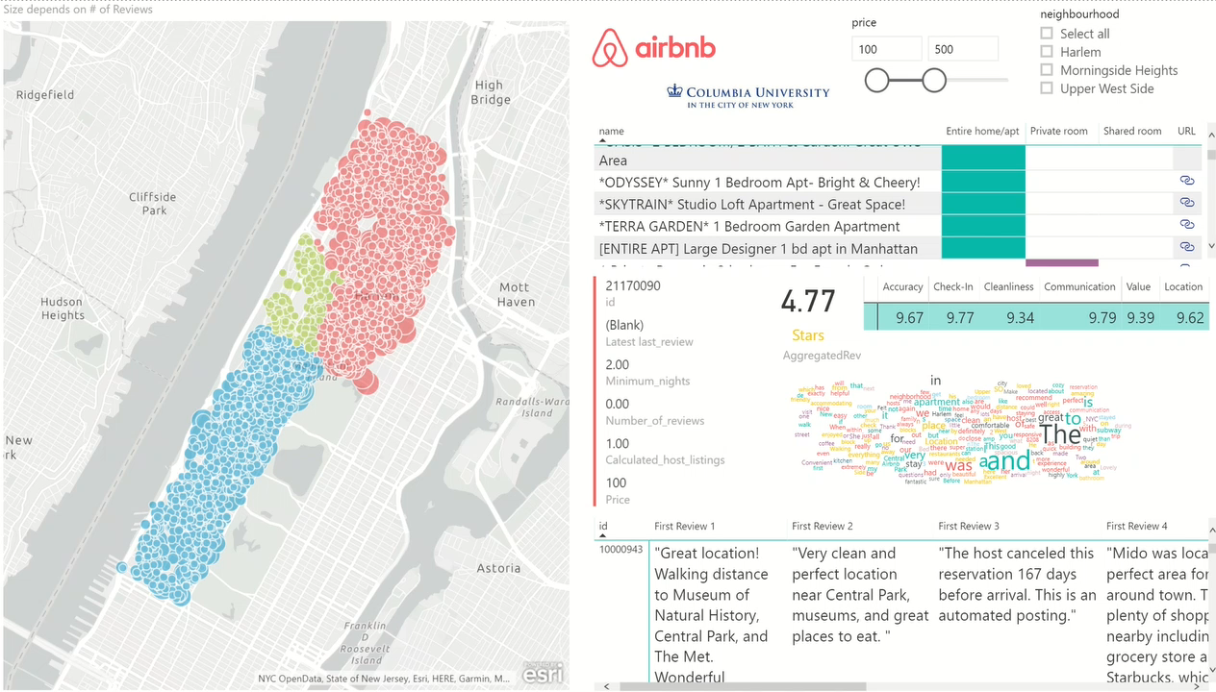
As an alternative to our friends and family, we decided to implement an interactive tool to help make a decision
Due to the particular case of these neighborhoods and the complexity involved trying to predict the value we built a Dashboard to help ease the process of looking for the right option
Price Selection
Neighborhood Selection
Listing, Type of Room & URL
Rankings
Word Cloud Visual Aid
Listing Features
Reviews
URL for Dashboard (Map will not show in Web due to License Issues, but is available in original PowerBI file)
https://app.powerbi.com/view?r=eyJrIjoiMzE0OTc4ZDEtZTE0ZC00NWU1LWIyYmYtMDk1NDAxNmQyN2QyIiwidCI6IjA2ZDdlNTFiLTU4M2MtNDA4ZC05ZDY3LTQyNzI3YzcwM2NlNCIsImMiOjR9
Notes:
Understand the process to find the investing companies is done manually. It is manually done, they don’t have the right criteria, they can have missed opportunities.
Possible solution
Have an automatic process based on selected criteria that can be automatically updated in order to enhance the selecetion process and giving them the time to focus on what matters, building the relation.
There is no database or control group
Prioritization of clients for reaching them

Slide 14
Thank You

